Slide 1
Project CI2
Anonymization and post-course analysis of Gradescope submissions
PRESENTED BY:
Weilin Tian - a1880923
Chunyu Zhang - a1751743
Yuetong Li - a1898722
Dan Li - a1906529
Fan Yang - a1910537

Slide 2
Final Presentation Agenda
Part 1 | Background, Objectives & Data Source
Part 2 | Local Anonymization
Part 3 | Single-course Anonymization Demo
Part 4 | Multi-course Scenario Anonymization Demo
Part 5 | Testing Report
Part 6 | Project Summary & Key Achievements

Slide 3
Project CI2
PRESENTED BY:
Weilin Tian (a1880923)
Project Background
The Problem Gradescope only supports anonymization at the assignment level, not across the full course.
Why It Matters Without full-course anonymization, there is a risk of re-identifying students through:
File names
Timestamps
Writing or coding patterns
The Impact This also limits cross-course and long-term analysis for instructors.
Our Goal ✔ Build a tool for consistent, course-wide anonymization ✔ Supports both local saving and Gradescope upload

Slide 4
Project CI2
PRESENTED BY:
Weilin Tian (a1880923)
Project Objectives
This project delivers a functional script that automates the workflow of:
Downloading student submissions and course rosters from Gradescope
Removing personally identifiable information (PII) locally using anonymization mapping
Uploading anonymized files and rosters back to Gradescope for grading and analysis

Slide 5
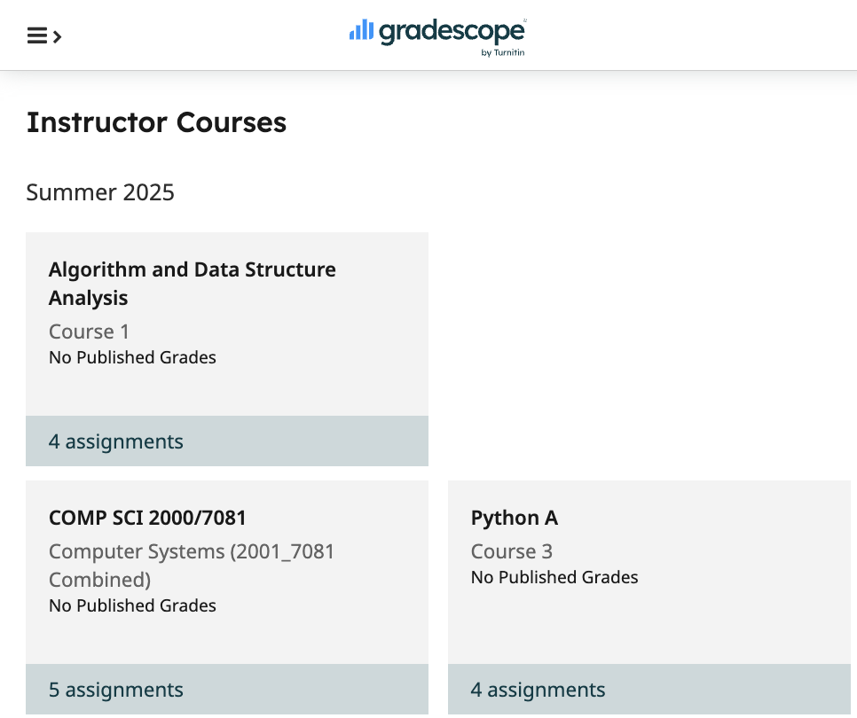
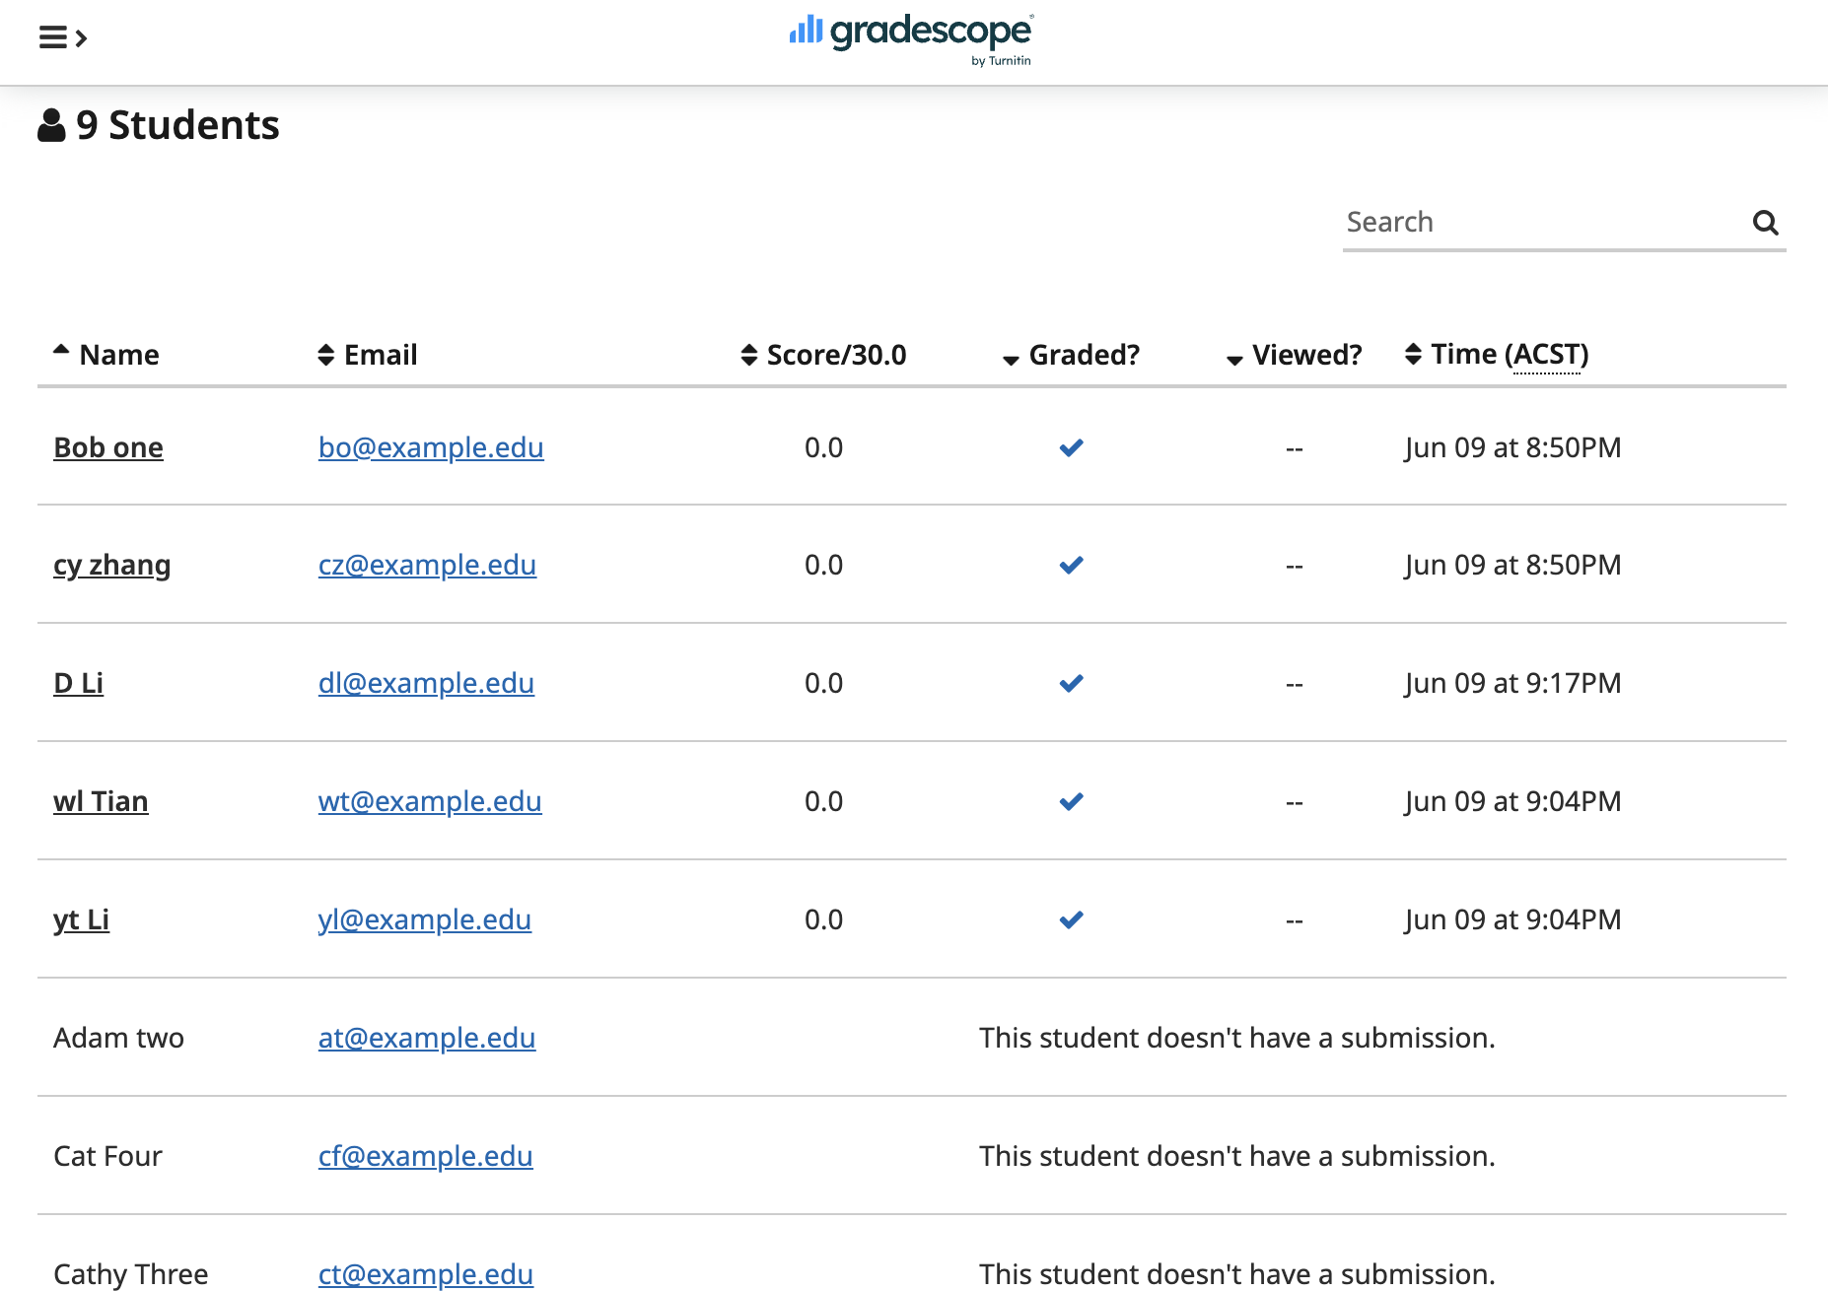
Project CI2
PRESENTED BY:
Weilin Tian (a1880923)
Data Source Explanation
Real data used in this project:
Actual assignment submissions from our own courses
Sourced from 2–3 different real courses created in Gradescope:
These courses were created under instructor accounts and include real assignments used for testing and validation.

Slide 6
Demonstration
27

Slide 7
Project CI2
PRESENTED BY:
Chunyu Zhang (a1751743)
Local Anonymization mode:
Downloading from selected course from Gradescope
Anonymization assignment files and save it locally

Slide 8
Project CI2
PRESENTED BY:
Chunyu Zhang (a1751743)
GradeScope Anonymization mode:
Downloading from selected course from Gradescope
Anonymization assignment files and save it locally
Addition:
Upload anonymized assignment files to selected course in Gradescope

Slide 9
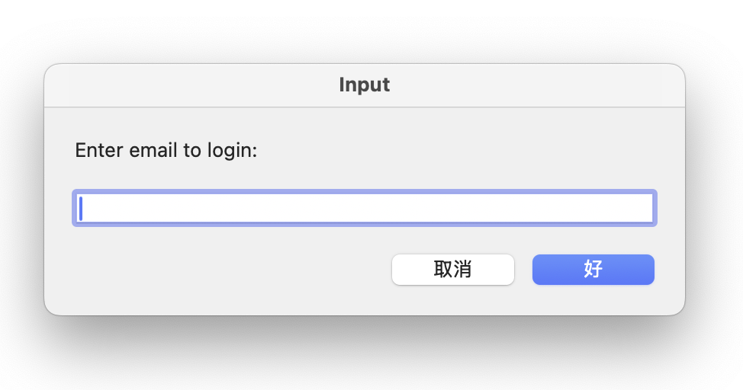
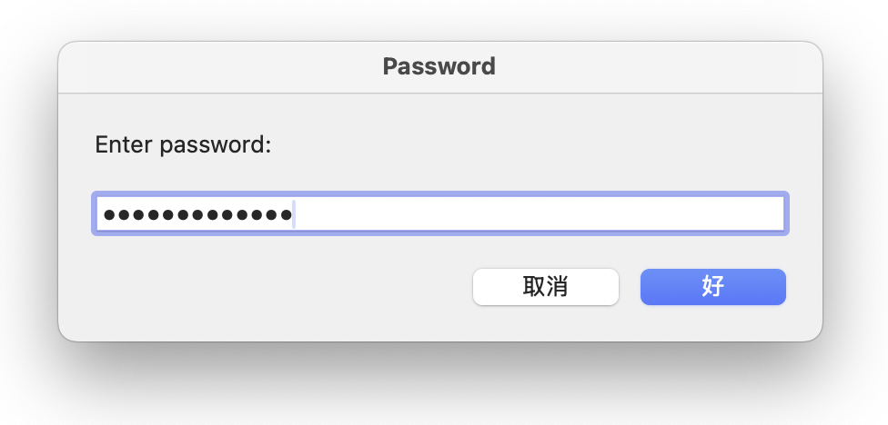
Login
Hide password characters

Slide 10
Demonstration
(local anonymization)
27

Slide 11
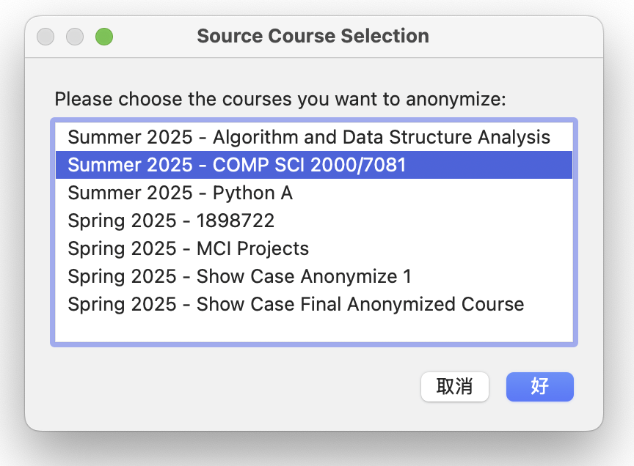
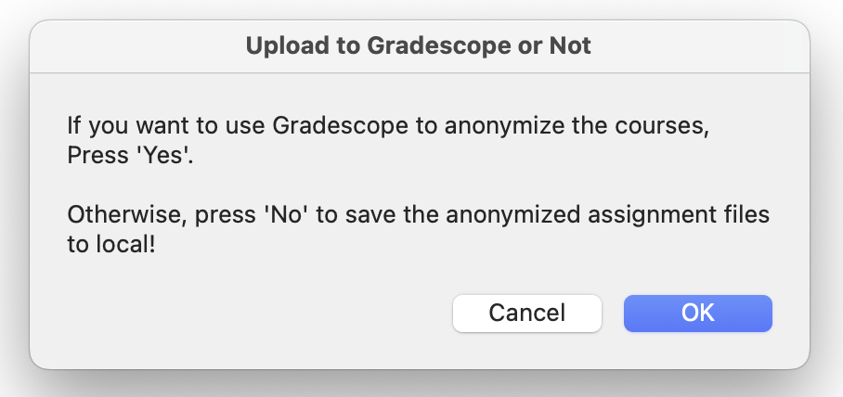
Choose course
Press ‘Cancel’ to choose local anonymization

Slide 12
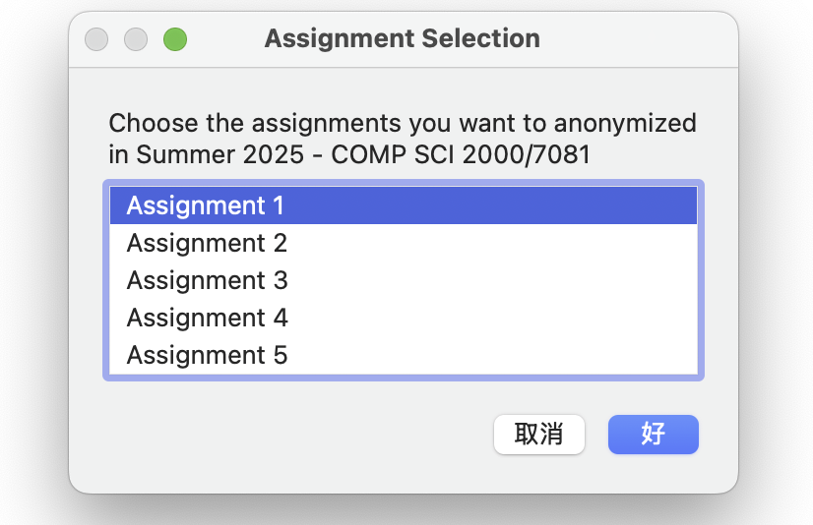
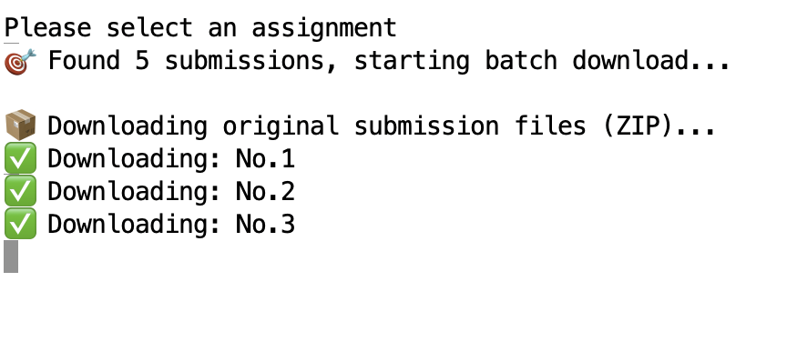
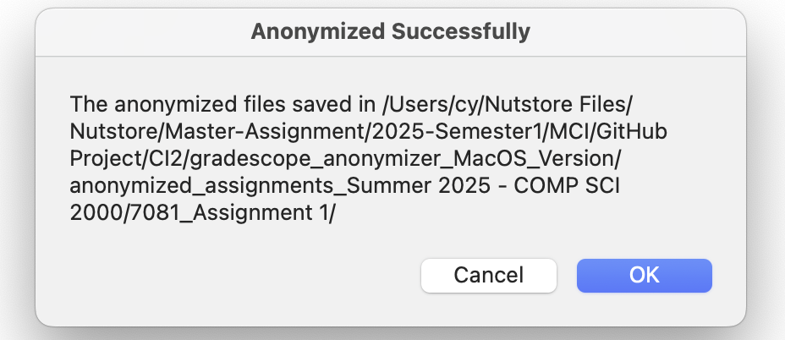
Choose assignments
Show downloading message in terminal
Show path of anonymized assignments

Slide 13
Demonstration
(single course)
27

Slide 14
Choose course
Press ‘OK’ to choose Gradescope anonymization

Slide 15
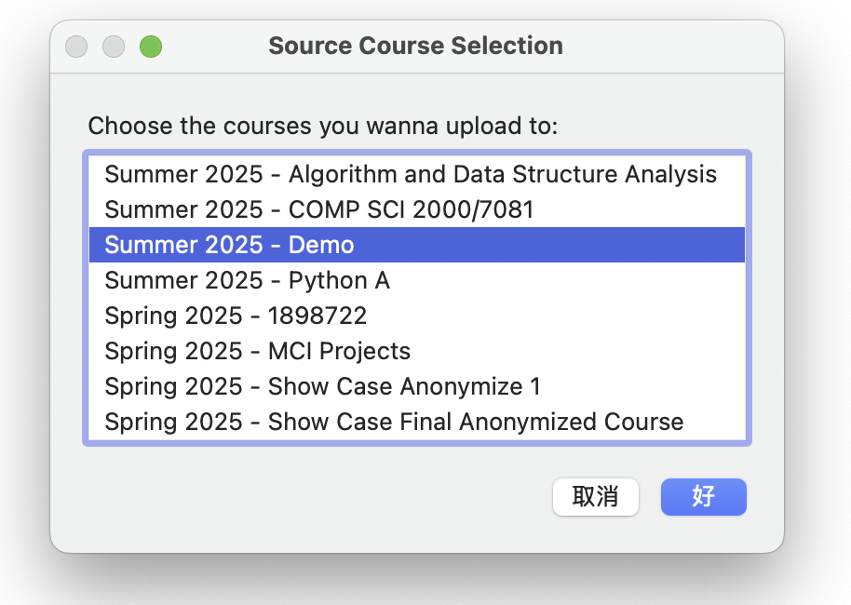
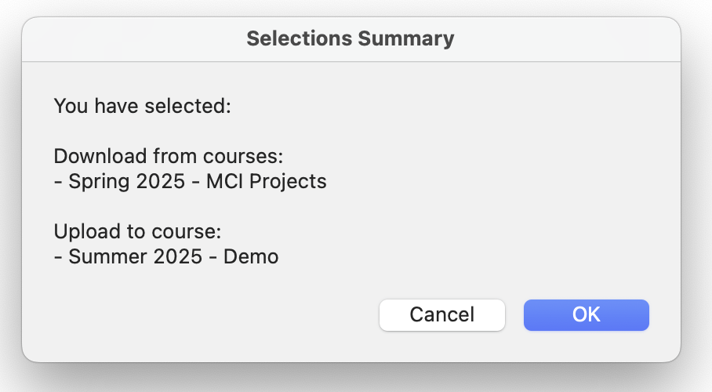
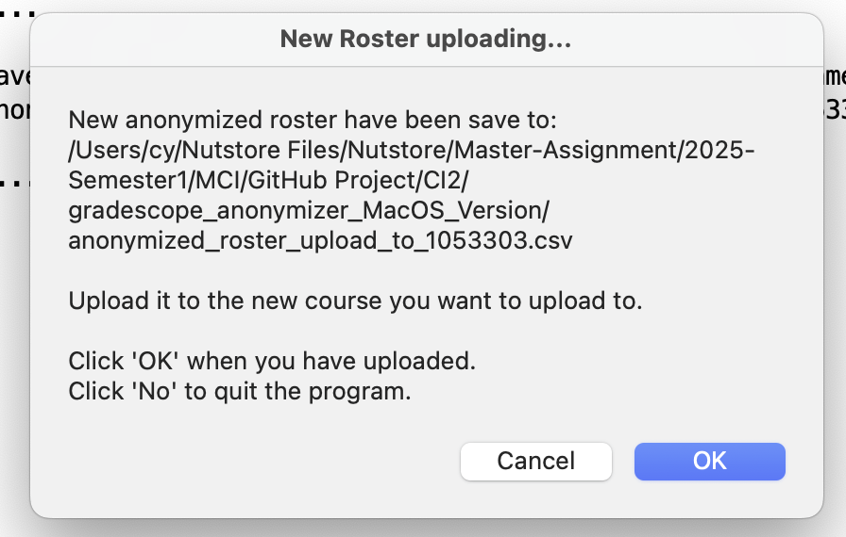
Choose course user want to upload to
Show selected courses
Show path of anonymized roster and notify user to upload it on the Gradescope webpage

Slide 16
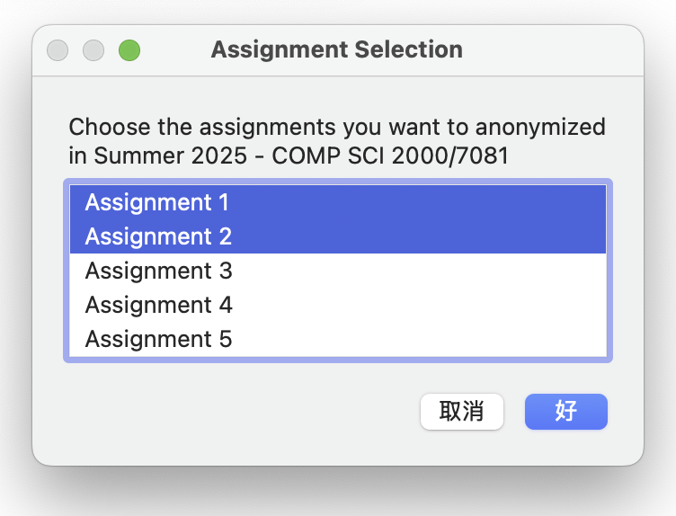
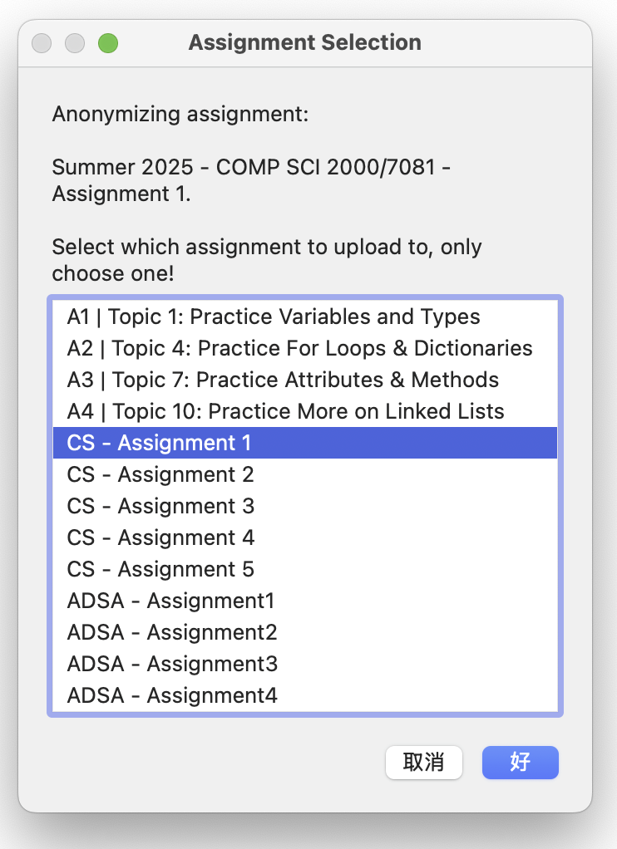
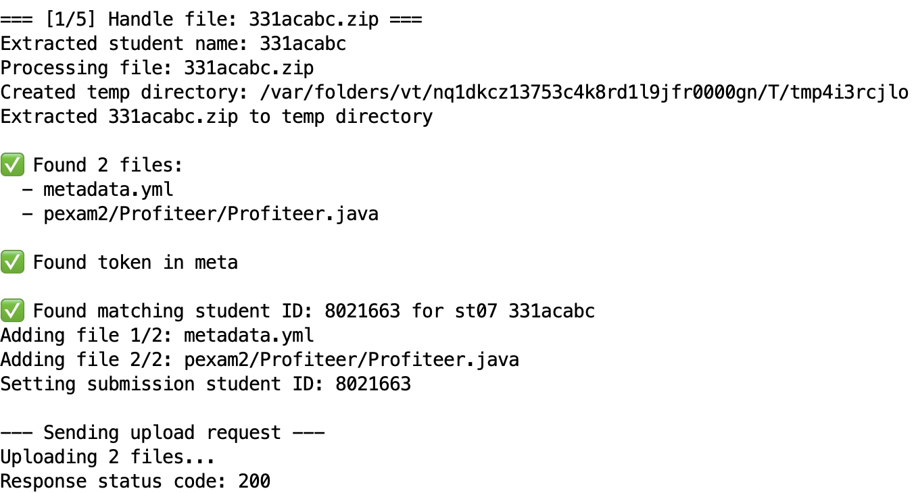
Choose anonymize assignments of selected course
Choose where to upload anonymized assignments one by one
Show uploading process

Slide 17
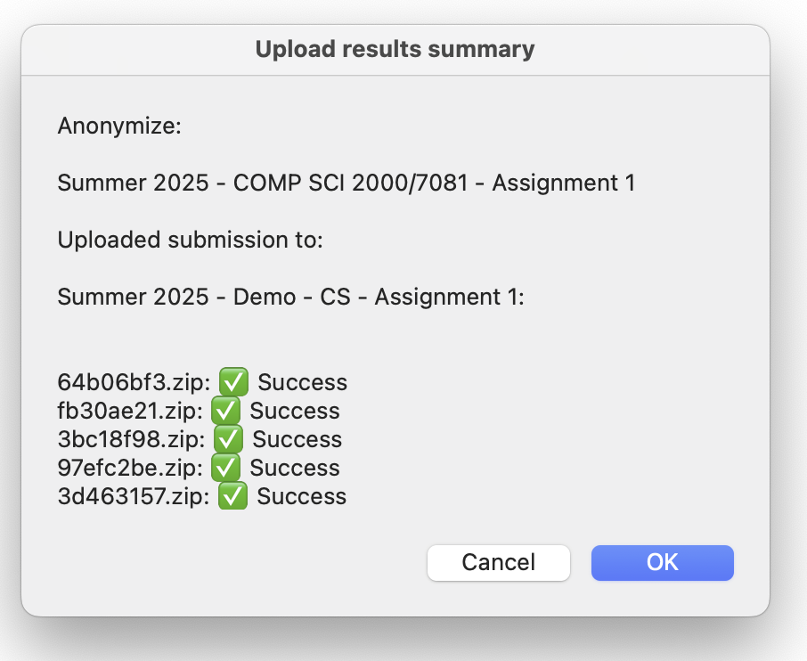
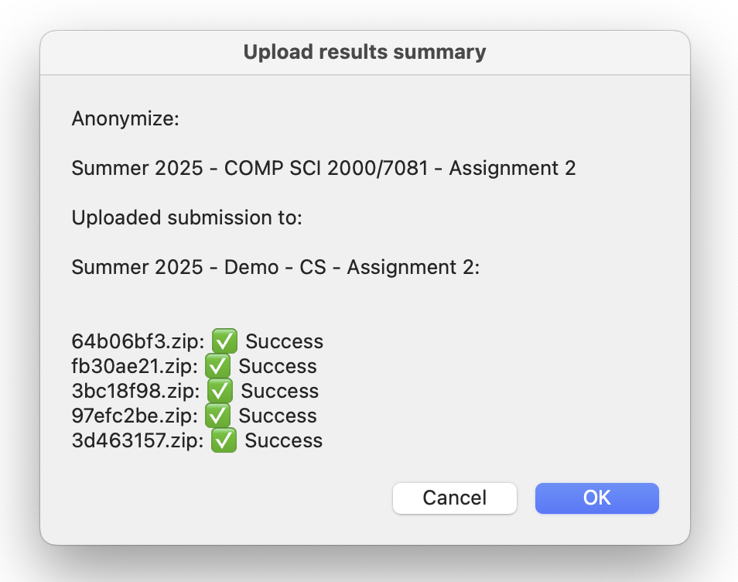
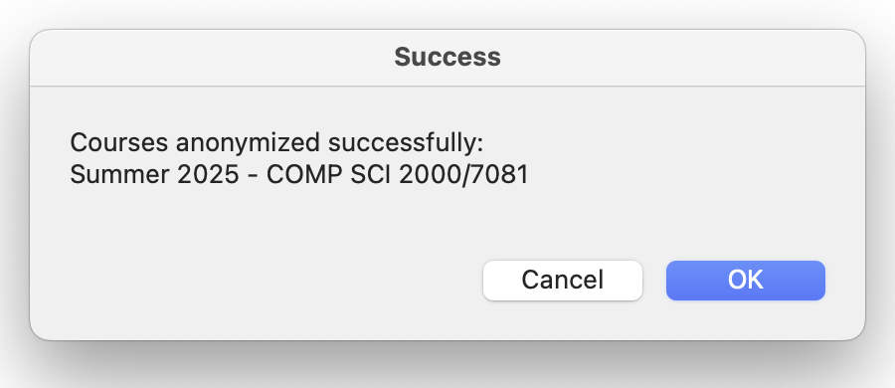
Show results of each assignment upload processing
Show successful anonymization of course in final message

Slide 18
Demonstration
(multi-course)
27

Slide 19
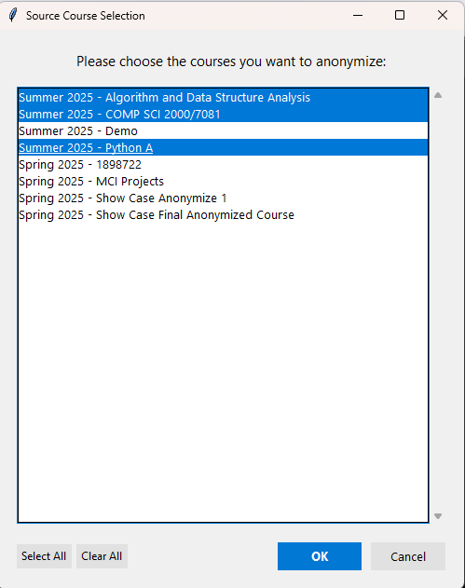
Project CI2
Choose courses that needs anonymization.
PRESENTED BY:
Yuetong Li (a1898722)
This also shows that our script can run on both OS.

Slide 20
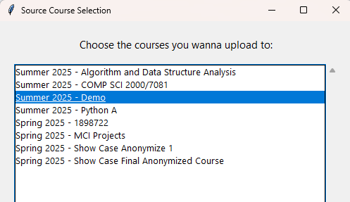
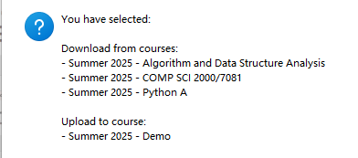
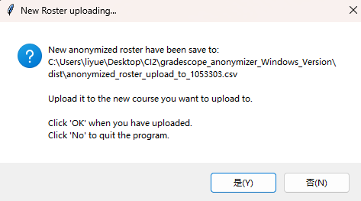
Choose course user want to upload to
Show selected courses
Show path of anonymized roster and notify user to upload it on the Gradescope webpage

Slide 21
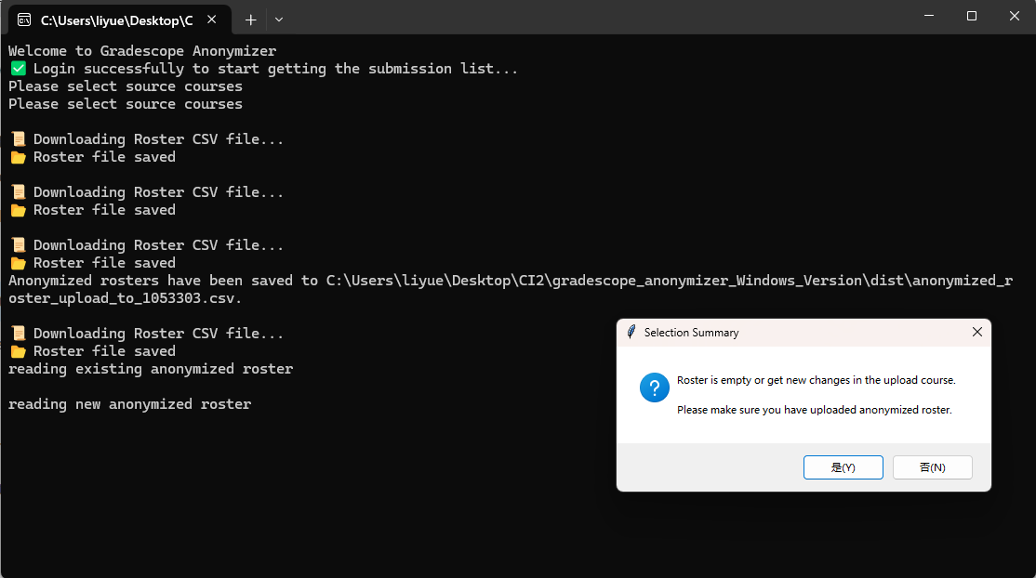
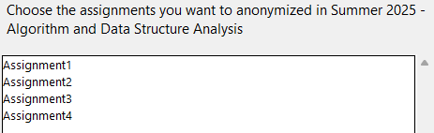
Show message if users didn’t upload the roster
Choose anonymize assignments of selected courses

Slide 22
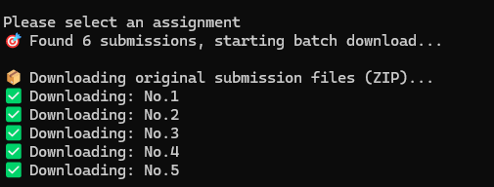
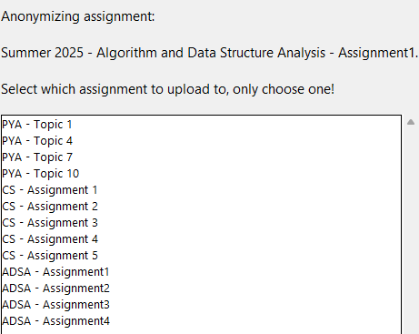
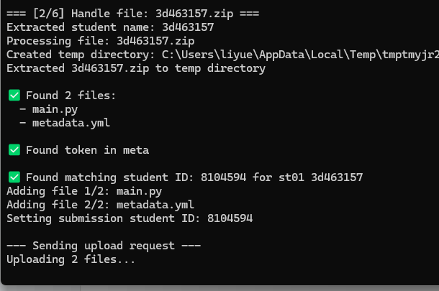
When choose assignments, submissions will be downloaded
The script will do the anonymization like multi-assignments in single course for every chosen courses.

Slide 23
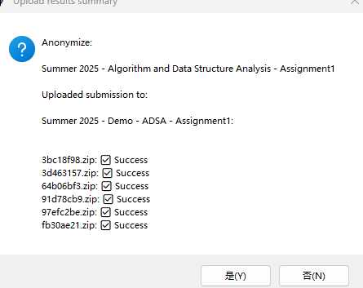
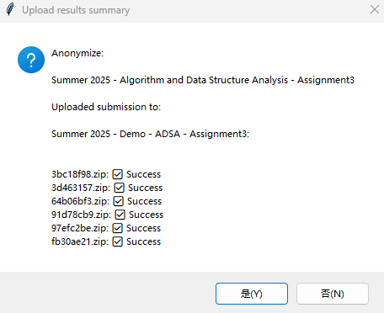
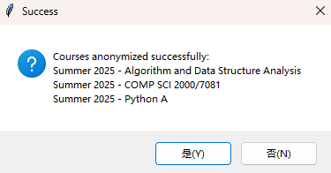
The results will be shown when every single assignment has been anonymized
A reminder will pop up when all uploading has been finished

Slide 24
Testing Report
29

Slide 25
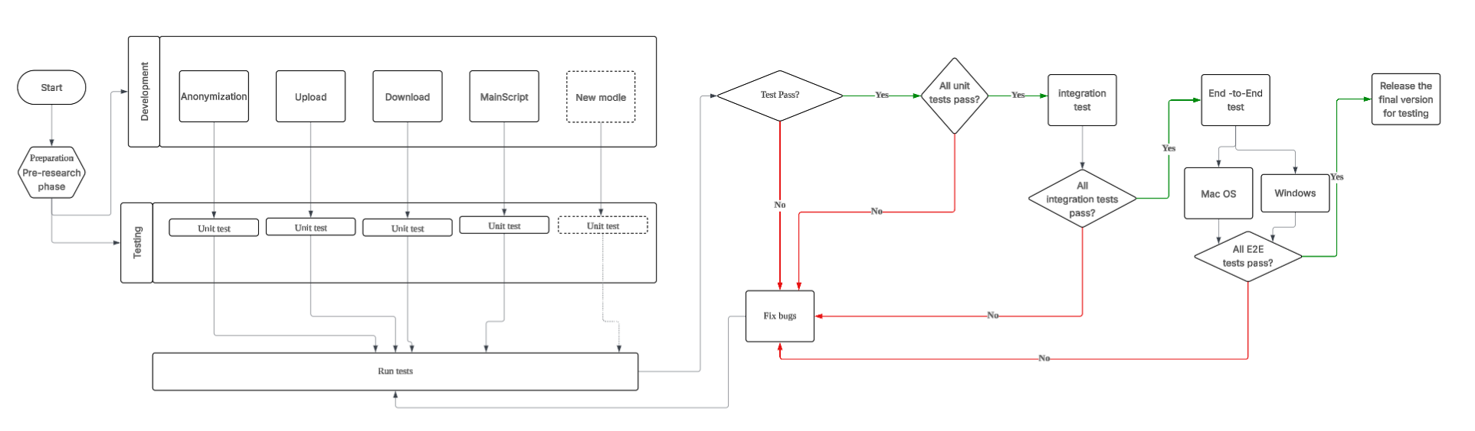
Project CI2
PRESENTED BY:
Dan Li (a1906529)
Testing Methodology
The team utilizes an AGILE testing process with testing throughout the development cycle
Test Flow Diagram

Slide 26
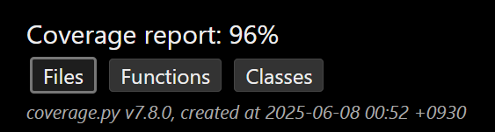
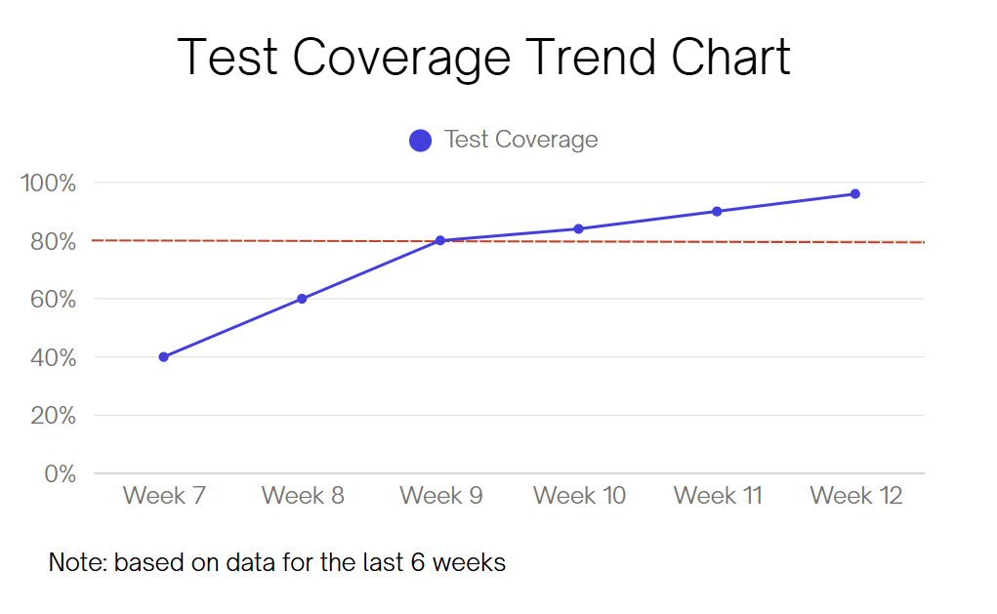
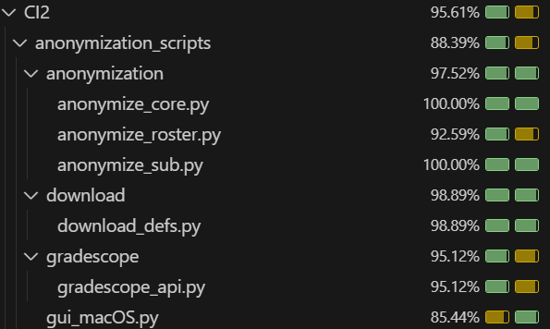
Test Coverage
,
,
While there's no universal standard, most industry experts recommend aiming for 70-80% code coverage for critical applications.
(F22 Labs 2022)
,
,
96%
recommended standard
F22 Labs 2022, What is test coverage and what you need to know, F22 Labs, viewed 9 June 2025, https://www.f22labs.com/blogs/what-is-test-coverage-and-what-you-need-to-know/

Slide 27
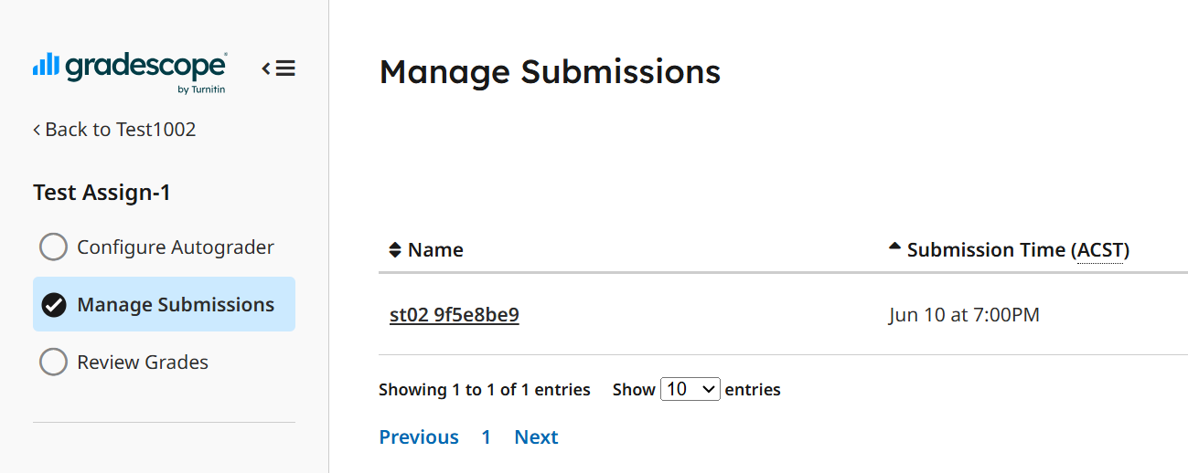
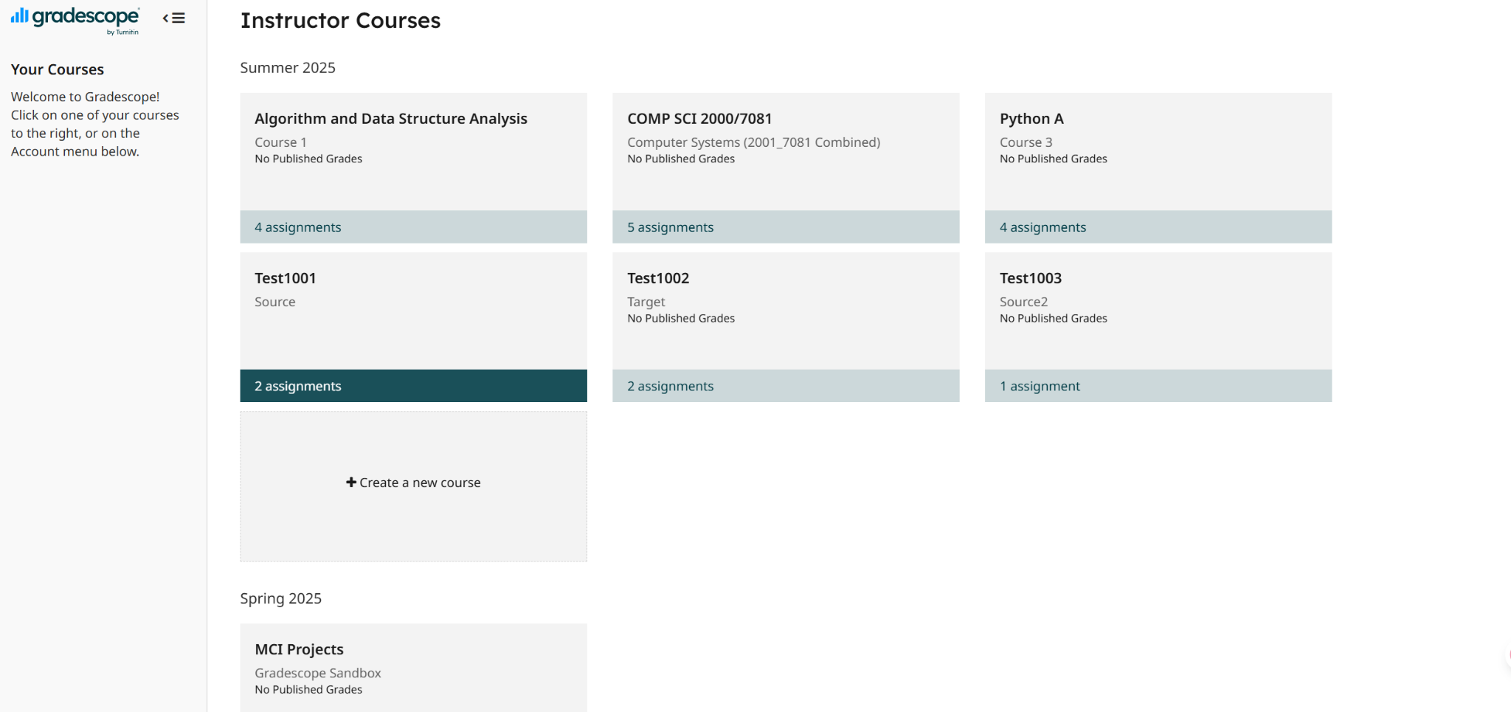
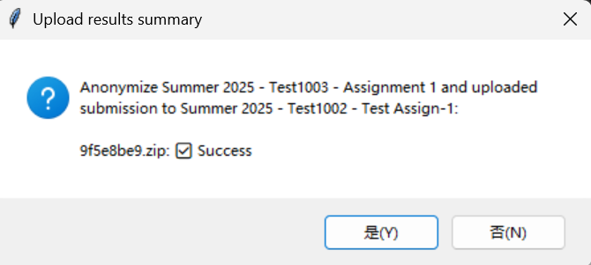
Beyond the testing code…
User acceptance tests
Try to be a user to do user acceptance tests

Slide 28
Project Summary & Key Achievements

Slide 29
Project CI2
PRESENTED BY:
Fan Yang (a1910537)
Project Summary
Automate the process of downloading, anonymizing and returning assignments on the Gradescope platform
Protect student privacy while facilitating subsequent grading and instructional data analysis
Local anonymization mode: download → anonymize → save locally
Gradescope anonymization mode: download → anonymous → upload to target course
Graphical interaction: support for selecting courses and assignments, path display and terminal prompts.
Cross-platform compatibility: Scripts run on both Windows and macOS.

Slide 30
Key Achievements:
Our communication in this group work was very good, and when we encountered difficulties, we would find everyone to solve the problem together in time.
When designing, the user experience is well considered and the page is simple and good-looking.
Development and testing based on real course and assignment submission data ensured the tool's practicality.
Cross-platform support, strong environmental adaptability

Slide 31
Thanks for listening

